Slide 1
딥러닝 원리 및 이론 배우기
08 – CNN

Slide 2
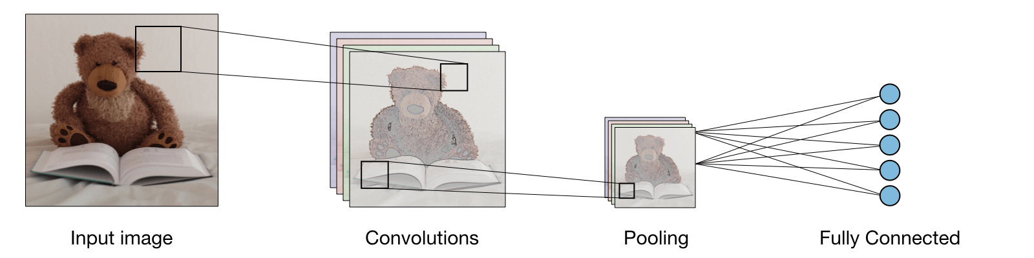
stanford.edu/~shervine/teaching/cs-230/cheatsheet-convolutional-neural-networks

Slide 3
stanford.edu/~shervine/teaching/cs-230/cheatsheet-convolutional-neural-networks

Slide 4
stanford.edu/~shervine/teaching/cs-230/cheatsheet-convolutional-neural-networks

Slide 5
stanford.edu/~shervine/teaching/cs-230/cheatsheet-convolutional-neural-networks

Slide 6
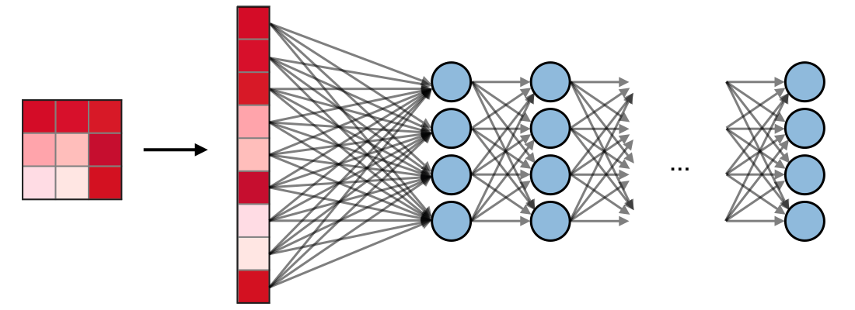
stanford.edu/~shervine/teaching/cs-230/cheatsheet-convolutional-neural-networks

Slide 7
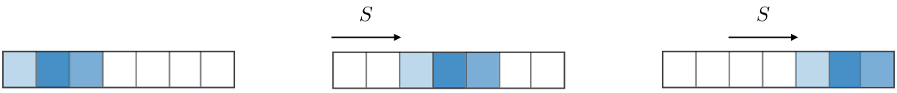









stanford.edu/~shervine/teaching/cs-230/cheatsheet-convolutional-neural-networks

Slide 8









stanford.edu/~shervine/teaching/cs-230/cheatsheet-convolutional-neural-networks

